Slide 1

IDBC BANK PROJECT
PRESENTED BY: HARSH SINGH (wave26)
MENTORS: SANGEETHA MAM, HASIB SIR, SAURABH SIR

Slide 2
TABLE OF CONTENTS
Introduction
Problem Statement
Requirements
Objective and Functionality
Applications Requirements
Class Diagram
E.R Diagram
Advantages and Disadvantages
Conclusion

Slide 3
Why we need this project
Since online banking is one of the major services offered by banks, it is also a highly secure platform. Banks generally use encryption devices to ensure that all client information is protected and there is no security breach. It ultimately provides you security from online frauds and account hacking
You can quickly transfer money between accounts when you do it online. It's more convenient than going to a bank in person or using an automated phone service, which requires you to provide information when prompted.
Online banking allows you to access your account history and transactions from anywhere. This is the quickest way to see whether a transaction has cleared your account. It also enables you to find out about any unauthorized transactions more quickly, so you can dispute them right away.

Slide 4
Problem
Banking services are also majorly online, but to open a bank account, one has to visit the bank in person. Many global banks have ventured into the new era of banking. They allow their customers to open their bank account from the comfort of their homes. IDBC bank is now providing the facility of opening an account onto its online platform. They provide this service to individuals who are more than 18 years of age. However, not all types of accounts can be opened online.
There are two types of accounts that are provided. Save Account – acts like a normal single owner savings bank account Pay Account – to make bill payments, do online shopping and more The software team at IDBC Bank needs to build an application that will help customers to open the save and pay bank account. Features of the Bank accounts

Slide 5
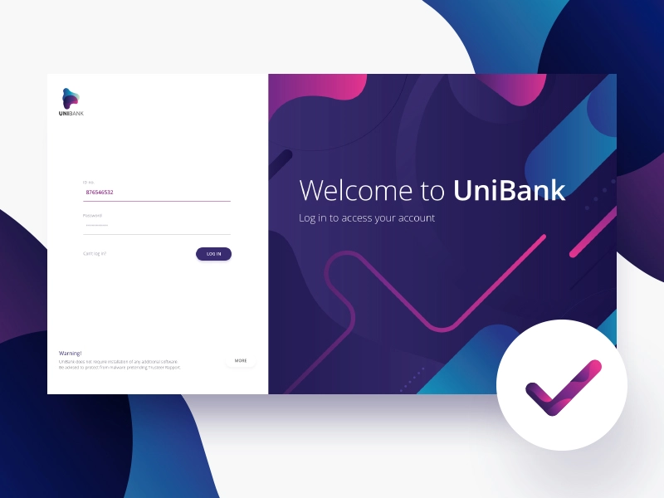

Slide 6
Requirement
Save Account • Must have a 12 digit auto-generated account number • Interest is calculated on the available balance and credited into the account on yearly basis, the interest rate for customers is 2.5%
Pay Account • Must have a 12 digit auto-generated account number • No interest is calculated on the amount available in the account
Identify the entities and attributes to design the database tables.
Ensure that appropriate constraints are applied on the tables designed.
All the data for the bank operations such as balance check, withdrawal, etc., must be read from the database.
A log of transactions is maintained for each customer.

Slide 7
Objectives And Functionality
Create New User Account
Maintain Statement of every transaction
Login Existing Customer Account
-> Deposit Money
-> Withdraw Money
-> Fund Transfer
-> Check Balance
-> Exit

Slide 8
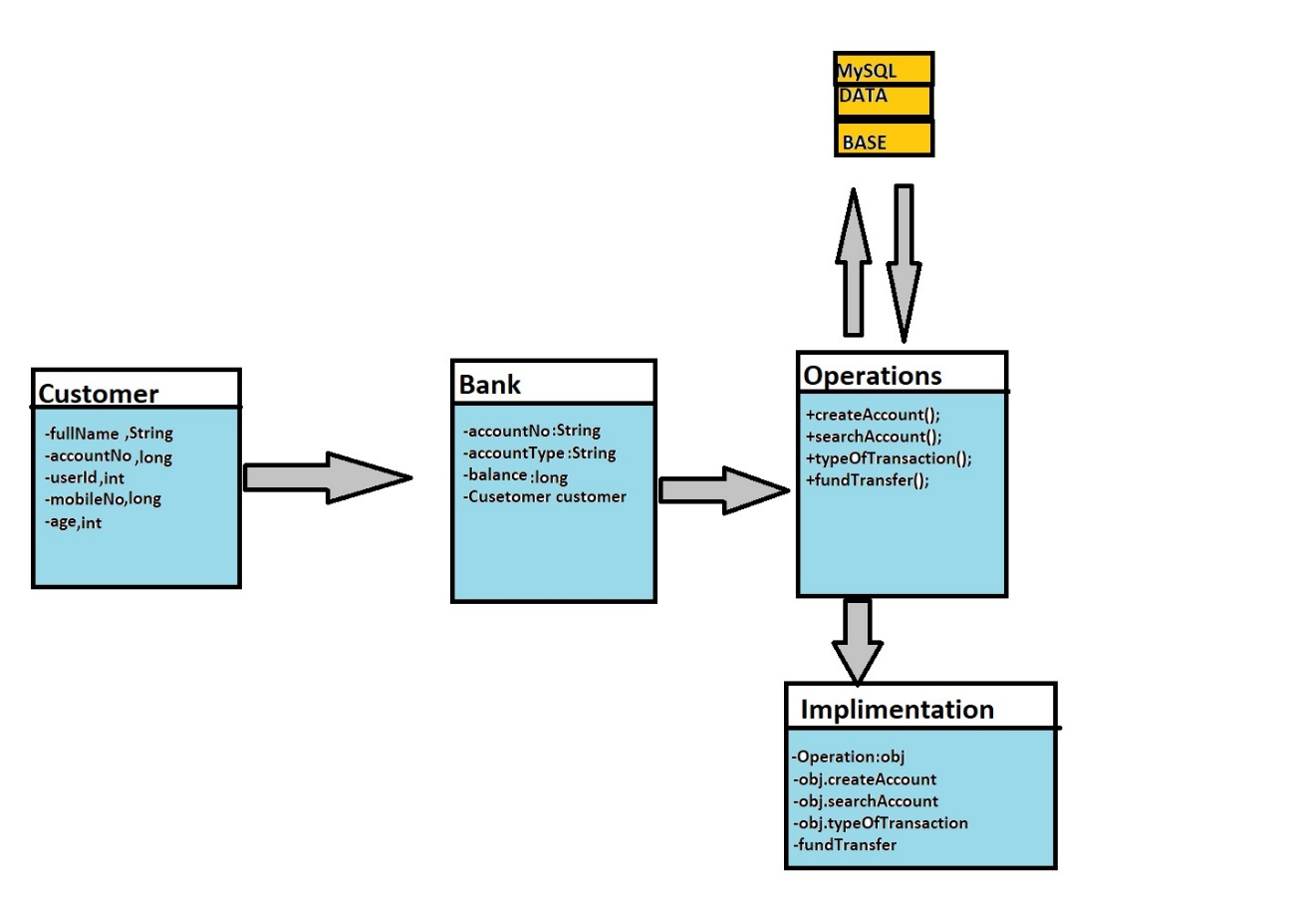
CLASS DIAGRAM

Slide 9
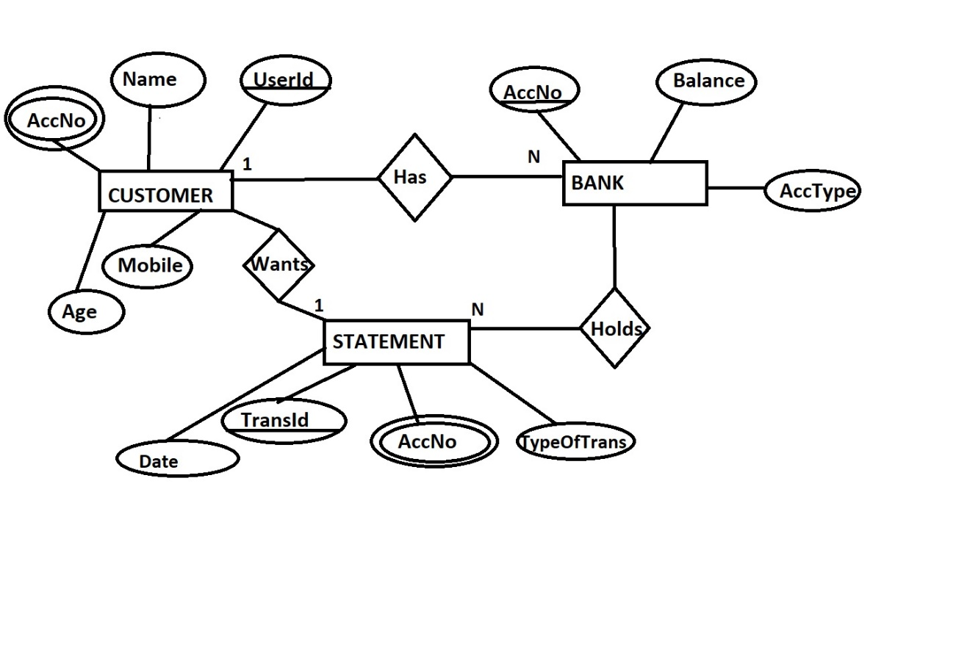
ENTITY RELATIONSHIP DIAGRAM

Slide 10
Applications Required
MySQL
Server Database
Java 1.8 or Above
J.D.B.C
Java Connector
Any of IDE

Slide 11
ADVANTAGES AND DISADVANTAGES
ADVANTAGES
-> You can open a new account within minutes and from anywhere online.
-> Access to banking information protected by multiple protection layers to keep your personal data private and prevent unauthorized access
-> Skip the long lines. Easily check balances on all accounts and view records of transactions from the palm of your hand.
-> Avoid late fees by scheduling all of your loan payments before the due date
DISADVANTAGES
-> This is not online server so it is only accessible by one system

Slide 12


